Slide 1
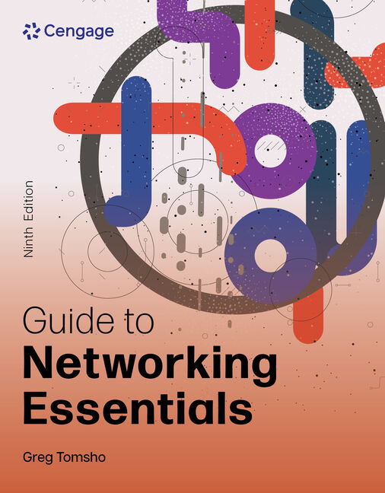
Guide to Networking Essentials, 9e
Part 1
Chapter 11: Network Operating System Fundamentals
.

Slide 2
Chapter Objectives
By the end of this chapter, you should be able to:
Explain the major components of an OS, including the file system, processes, and the kernel
Describe client and server operating systems and compare client and server OSs
Describe the components of virtualization and virtualization products
Explain the process of installing an OS, including preinstallation and post-installation tasks

Slide 3
Operating System Fundamentals
A computer’s operating system (OS) provides a convenient interface for users and applications to access computer hardware components
The following sections will expand on the following OS concepts:
File systems
Processes and services
Kernel

Slide 4
The File System (1 of 7)
A file system is the method by which an OS stores, organizes, and manages access to files on a storage device (such as a hard drive)
File systems have the following objectives:
Provide a convenient interface for users and applications to open and save files
Provide an efficient method to organize space on a drive
Provide a hierarchical filing method to store files
Provide an indexing system for fast retrieval of files
Provide secure access to files for authorized users

Slide 5
The File System (2 of 7)
When a user double-clicks a file to open it, the user interface calls the file system with a request to open the file
The file type determines exactly how the file is opened
Most users of an OS interact with the file system by using a file manager program
Networking professionals need to have an understanding of how a file system works
In order to make informed choices when they need to install a file system or troubleshoot file system-related problems

Slide 6
The File System (3 of 7)
Storage space on a disk drive is divided into sectors
Sectors are grouped to make a disk cluster (or block)
A disk cluster is the smallest amount of space that can be occupied by a file
A disk’s cluster size is selected when the disk is formatted
If you know that you’re going to store many files under 2K bytes, choose a smaller cluster size when you format
The formatting process groups sectors into clusters and maps all disk clusters for fast access

Slide 7
The File System (4 of 7)
Most file systems organize files in a hierarchy of folders or directories
The top of the hierarchy is called the “root” of the file system
The root often represents a disk drive or other mass storage drive
Off the root of the file system can be files and folders, with folders containing files and additional folders (called subfolders)

Slide 8
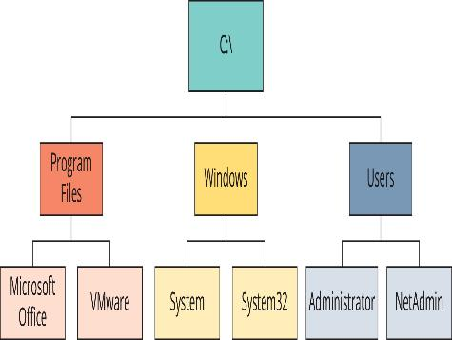
The File System (5 of 7)
Figure 11-2 A hierarchical file system

Slide 9
The File System (6 of 7)
With large disk drives, more files can be stored so it may be sometimes difficult to find files that might be needed
Most file systems include an indexing system that enables users to search for a file based on all or part of a filename
The indexing system maintains a database that’s updated as files are created
In Windows, configure the file system’s index by typing “indexing” in the search bar and clicking Indexing Options in the search results

Slide 10
The File System (7 of 7)
Computers are often shared at home and in the workplace
Each user may want files or documents that other users can’t access
A file system’s access controls (permissions) can be used to allow only authorized users to access certain files or folders
Access controls can be used to secure OS files from accidental corruption or deletion
Most current OSs include access controls
Older FAT file systems don’t support file and folder permissions

Slide 11
Processes and Services (1 of 3)
A process is a program that is loaded into memory and run by the CPU
It can be an application or a program that communicates with and provides services to other processes (called a service in Windows and a “daemon” in Linux)
Network services allow your computer and applications to perform tasks they otherwise couldn’t
Example: When using a Web browser to access a Web server most people use a name rather than its address. A name lookup is required before a Web browser can do its main job. Domain Name Service (DNS) runs as a process to provide the name lookup service.

Slide 12
Processes and Services (2 of 3)
An OS can run many processes at the same time by using multitasking
A computer multitasks by using a method called time slicing—occurs when a CPU’s computing cycles are divided between more than one process
The act of changing to another process is called context switching
Two types of multitasking:
Preemptive—the OS controls which process gets access to the CPU and for how long
Cooperative—the OS can’t stop a process; a process maintains control until it satisfies its computing needs

Slide 13
Processes and Services (3 of 3)
Many applications are now designed so that different parts can be scheduled to run separately
Each part that can be scheduled to run is called a thread (the smallest unit of software scheduled)
A multithreaded application has two or more threads that can be scheduled separately for execution by the CPU
Multiprocessing allows performing multiple tasks or threads simultaneously, each by a different CPU or CPU core

Slide 14
The Kernel (1 of 2)
The kernel performs the following tasks:
Schedules process to run, making sure high-priority processes are taken care of first
Manages memory to ensure that two applications don’t attempt to use the same memory space
Makes sure I/O devices are accessed by only one process at a time
OSs are designed in layers
The kernel is usually shown as the layer just above the hardware

Slide 15
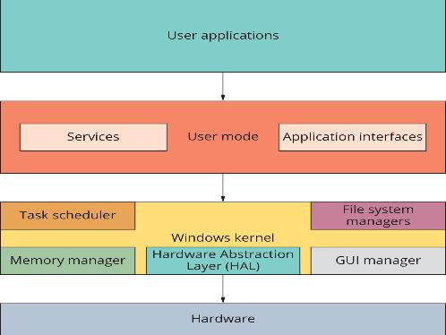
The Kernel (2 of 2)
Figure 11-3 The Windows OS structure

Slide 16
Client and Server Operating System Overview
Client OSs usually come with client software, such as Web browsers, DNS and DHCP clients, and file-sharing clients
Most server OSs include client software but have server components, such as Web servers, DNS and DHCP servers, and file-sharing servers
Client OSs include many features once found only on a server OS
The determining factor of whether you need a server OS or a client OS is the role the computer will play in your network

Slide 17
The Role of a Client Operating System (1 of 7)
The main purpose of the client OS is to run applications, which often access network resources
Most desktop computers have the following network client software:
DHCP client
DNS client
HTTP client (Web browser)
File-sharing client
Email client

Slide 18
The Role of a Client Operating System (2 of 7)
A file-sharing client allows the computer to access files and printers on the network
When a resource has been requested, a redirector intercepts the request and examines it to determine whether the resource is local (on the computer) or remote (on the network)
With redirectors, network resources can be accessed as though they were local
With drive mapping, shared network folders are accessed just like a drive that is physically attached to the system

Slide 19
The Role of a Client Operating System (3 of 7)
Two common ways to access a shared resource are as follows:
UNC example: \\server-name\sharename\subfolder\filename
Using the net command example:
net use drive-letter:\\server-name\sharename
The drive-letter is an unused driver letter and must be followed by a colon (:)
The command can be entered at a command prompt, logon script or batch file
A batch file is a text file containing a list of commands you ordinarily type at the command prompt

Slide 20
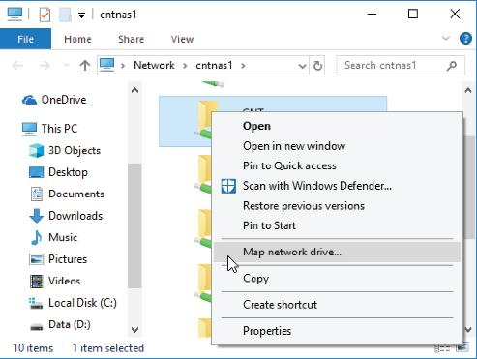
The Role of a Client Operating System (4 of 7)
Figure 11-10 Mapping a drive in File Explorer

Slide 21
The Role of a Client Operating System (5 of 7)
The protocol used in Windows to share files and printers is SMB, also known as Common Internet File System (CIFS)
Linux also supports SMB implemented as an installation option called Samba
The native file-sharing protocol in the Linux environment is Network File System (NFS)

Slide 22
The Role of a Client Operating System (6 of 7)
Email is based on its own set of protocols
The most common email protocols are as follows:
Post Office Protocol version 3 (POP3)—this protocol is used to download incoming messages from an email server to local desktops
Simple Mail Transport Protocol (SMTP)—the standard protocol for sending Internet and other TCP/IP based email
Internet Message Access Protocol (IMAP)—this standard has advanced message controls, including the capability to manage messages locally yet store them on a server

Slide 23
The Role of a Server Operating System (7 of 7)
Memory, CPU, and disk use in client OSs are optimized to run user applications and client network software
These resources are optimized to run network services in the background to speed up responses to client requests
Most server OSs in a typical network provide:
Centralized user account and computer management
Centralized storage
Infrastructure services, such as name resolution and address assignment
Server and network fault tolerance such as RAID and clustering

Slide 24
Centralized User Account and Computer Management (1 of 5)
A server-based network is centralized management of network resources, which includes the following functions:
User authentication and authorization
Account management
Security policy management

Slide 25
Centralized User Account and Computer Management (2 of 5)
Authentication is the process of identifying who has access to the network
The most common form is a logon with a username and password
Other forms include digital certificates, smart cards, and biometric scanners
Authorization is the process of granting or denying an authenticated user’s access to network resources

Slide 26
Centralized User Account and Computer Management (3 of 5)
Most OSs offer account management for authentication/authorization
The server version of Windows OSs includes a centralized account management, authentication, and authorization system called Active Directory
When Active Directory is installed on a server, the server becomes a domain controller and users and computer with accounts are referred to as domain members
When a computer running a desktop or server version of Windows becomes a domain member, an account is created for the computer in Active Directory

Slide 27
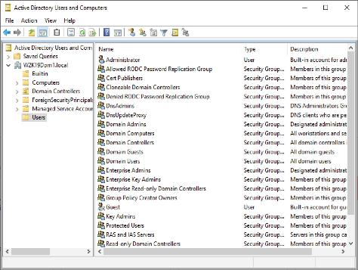
Centralized User Account and Computer Management (4 of 5)
Figure 11-11 The Active Directory Users and Computers management console

Slide 28
Centralized User Account and Computer Management (5 of 5)
Accounts in Active Directory are used to distribute and enforce policies for network use and security
These policies are called “group policies”
Policies can control what icons appear on a user’s desktop or can control password restrictions and what applications a user can run on a computer
Linux OSs have a basic directory service called Network Information Service (NIS)
Lightweight Directory Access Protocol (LDAP) supports both Windows and Linux user authentication and authorization

Slide 29
Centralized Storage (1 of 3)
Part 2
Network storage includes:
File sharing
Storing email, user files, application databases, data backups and more
Many network administrators are using specialized devices to help manage their storage:
Network-attached storage devices
Storage area networks
Cloud-based storage

Slide 30
Centralized Storage (2 of 3)
A network-attached storage (NAS) device is a dedicated server designed solely for providing shared storage for network users
Storage area network (SAN) technology allows multiple servers to access a large amount of storage that appears as locally attached drives
Cloud-based storage means some or all of an organization’s data is stored on servers located offsite and maintained by a storage hosting company

Slide 31
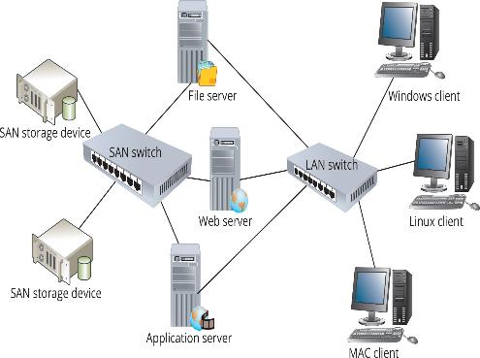
Centralized Storage (3 of 3)
Figure 11-13 A storage area network

Slide 32
Server and Network Fault Tolerance
Fault-tolerance features on a server OS include the following:
Support for hot-swappable devices—hot-swappable devices can be removed, replaced, or added to a server while it is running
Server clustering—a server cluster is two or more servers configured to operate as a single unit
Failover cluster—if one server fails, the other takes over
Load-balancing cluster—spreading the workload among multiple computers
Redundant/high-end disk systems—disk controllers capable of a disk arrangement know as redundant array of independent disks (RAID) where if one disk fails, the data is preserved and the server can operate

Slide 33
Additional Server Features
Remote access—most server OSs support virtual private networks (VPNs)
Database server—server OSs support advanced database systems such as MySQL, SQL Server, and Oracle
Client/server applications—corporate e-mail systems and web-based application are examples
Virtualization—allows multiple OSs to run on the same physical computer at the same time

Slide 34
Knowledge Check Activity 11-1
What component of an OS determines whether a resource is local or remote?
a. Kernel
b. Device driver
c. File sharing
d. Redirector

Slide 35
Knowledge Check Activity 11-1: Answer
What component of an OS determines whether a resource is local or remote?
Answer: d. Redirector
Explanation: When a user or an application requests a resource—such as a printer or a data file—a redirector intercepts the request and then examines it to determine whether the resource is local (on the computer) or remote (on the network). If the resource is local, the redirector sends the request to the local software component for processing. If the resource is remote, the redirector sends the request over the network to the server hosting the resource.

Slide 36
Operating System Virtualization (1 of 4)
Virtualization is a process that creates a software environment to emulate a computer’s hardware and BIOS, that allows multiple OSs to run on the same physical computer at the same time
Virtual machine (VM) is the virtual environment that emulates a physical computer’s hardware and BIOS, and a guest OS is the operating system installed on a VM
Host computer is the physical computer the VM software is installed on
A host OS is the OS installed on a host computer on which the virtualization software is installed

Slide 37
Operating System Virtualization (2 of 4)
Virtualization terms (continued):
Virtualization software creates and manages VMs and creates the virtual environment in which a guest OS is installed
The hypervisor creates and monitors the virtual hardware environment, which allows multiple VMs to share physical hardware resources
A type 1 hypervisor runs directly on the host computer’s hardware and controls and monitors guest OSs (also called bare-metal virtualization)
A type 2 hypervisor is installed in a general-purpose host OS and the host OS access host hardware on behalf of the guest OS (also called hosted virtualization)

Slide 38
Operating System Virtualization (3 of 4)
Virtualization terms (continued):
A virtual disk consists of files residing on the host computer that represent a virtual machine’s hard drive
A virtual network is a network configuration created by virtualization
A snapshot is a partial copy of a VM made at a particular moment
A container is a lightweight form of virtualization that virtualizes the file system, processes, and network components, but share the kernel with the host OS

Slide 39
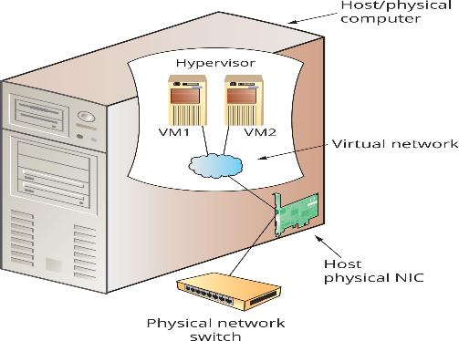
Operating System Virtualization (4 of 4)
Figure 11-15 How virtualization works

Slide 40
Hosted Virtualization (1 of 6)
Hosted virtualization uses a type 2 hypervisor
It has an advantage of supporting a wider variety of guest OSs because there are few incompatibility problems between the guest OS and hardware
Another advantage of hosted virtualization is that it’s easy and straightforward to use
Just install the software on your computer and begin creating virtual machines
The only hardware requirement is enough memory to support the host and guest OSs, adequate CPU power, and space to store the virtual disk

Slide 41
Hosted Virtualization (2 of 6)
The following are common hosted virtualization applications:
OS Training
Software Training
Application isolation
Network isolation
Software development
What-if-scenarios
Use of legacy applications
Physical-to-virtual conversion

Slide 42
Hosted Virtualization (3 of 6)
The following are well-known hosted virtualization products:
VMware Workstation Pro
VMware Fusion Pro
Parallels Desktop for Mac
VirtualBox
These products have strengths and weaknesses
Work with different products to see which best serves your needs

Slide 43
Hosted Virtualization (4 of 6)
Using VMware Workstation Pro
After VMware Workstation Pro is installed, a wizard takes you through the steps of creating a virtual machine
VMware Workstation Pro offers flexible networking options allowing you to configure the NIC on your VM to use one of the three virtual network options or you can create your own custom virtual network
Three preconfigured options:
Bridged
NAT
Host-only

Slide 44
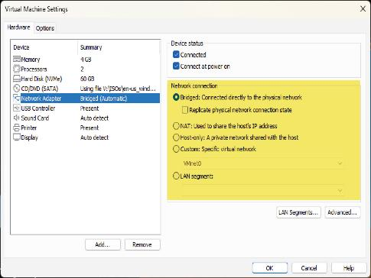
Hosted Virtualization (5 of 6)
Figure 11-16 VMware virtual network options

Slide 45
Hosted Virtualization (6 of 6)
Using VirtualBox
VirtualBox can be installed on Windows, macOS, Linux, and Solaris hosts and supports a wide range of Windows, Linux, and other guest OSs
The user interface consists of a console where you can create VMs and view the status of all VMs
VirtualBox supports unlimited snapshots, so you can save a VM’s state as you work with it and restore its state from any of the snapshots you make

Slide 46
Bare-Metal Virtualization (1 of 3)
Bare-metal virtualization products use a type 1 hypervisor
They are targeted mainly for production virtualization in data centers
These products are installed directly on hardware and have more stringent host machine requirements
They offer more features for managing VMs than hosted virtualization
They are a little more complicated to install and use as well

Slide 47
Bare-Metal Virtualization (2 of 3)
The following are a few bare-metal virtualization applications:
Consolidate servers
Test installation and upgrades
Test a preconfigured application
Test what-if scenarios
Live migration
Dynamic provisioning

Slide 48
Bare-Metal Virtualization (3 of 3)
The following are common bare-metal virtualization products:
Microsoft Hyper-V was introduced with Windows Server 2008 and can be installed as a server role
Citrix Hypervisor (also known as XenServer) uses Linux as a management OS on the host
VMware vSphere includes VMware ESX Server, which is installed directly on the physical server without a management OS
LXD is an open-source product from Canonical that can be installed on many Linux distributions including Ubuntu Server

Slide 49
Installing an OS
The real work of installing an OS, particularly a network server, involves pre-installation and post-installation tasks
The roles a server will play on the network should be considered when planning a server installation
A server used to support only a dozen users has different minimum hardware requirements than a server running Active Directory and supporting a few hundred users

Slide 50
Planning for and Installing Windows Server (1 of 4)
Selecting Server Hardware for Windows Server
Features you might want to consider before purchasing a server:
CPU architecture—the minimum requirement is a 1.4 GHz CPU
Disk subsystem—SAS vs. SATA
Memory—the minimum requirement is 512 MB RAM

Slide 51
Planning for and Installing Windows Server (2 of 4)
Selecting the Right Windows Edition
Datacenter edition is suitable for businesses managing huge amounts of data, using virtualization on a large scale, running high-end applications
Standard edition is suitable for most small to medium businesses
Permits only two virtual instances
Essentials edition is aimed at small businesses with 25 or fewer users
The Azure edition is the Datacenter edition optimized to run on Azure

Slide 52
Planning for and Installing Windows Server (3 of 4)
Windows Server Preinstallation Decisions
What should you name the server?
Which network protocols and addresses should you use?
How should you assign an IP address to the server?
Setting the correct time zone
Should you use the workgroup or domain model?
What services should you install?

Slide 53
Planning for and Installing Windows Server (4 of 4)
Windows Server Post-Installation Tasks
Activate Windows Server
Set the correct date, time, and time zone
Assign a static IP address
Assign a computer name
Download and install available updates
Add and configure roles and features

Slide 54
Planning for and Installing Linux
Decide which Linux distribution to use
A Web site called DistroWatch.com lists distributions along with descriptions
Download a disk image of the installation medium and create a bootable USB or DVD
The pre-installation and post-installation tasks for Linux are not very different from those for Windows Server
Linux requires more input and decision-making during installation

Slide 55
Knowledge Check Activity 11-2
What should you use for doing virtualization in a datacenter? (Choose two)
a. Type 1 hypervisor
b. Type 2 hypervisor
c. Bare-metal virtualization
d. Hosted virtualization

Slide 56
Knowledge Check Activity 11-2: Answer
What should you use for doing virtualization in a datacenter? (Choose two)
Answer: a. Type 1 hypervisor; c. Bare-metal virtualization
Explanation: A type 1 hypervisor implements OS virtualization by running directly on the host computer’s hardware and controls and monitors guest OSs. It also controls access to the host’s hardware and provides device drivers for guest OSs. Also called bare-metal virtualization, it’s used mainly for server virtualization in datacenters. Examples include VMware vSphere (or ESXi), Citrix Hypervisor, and Microsoft Hyper-V Server.

Slide 57
Self Assessment
Describe the difference between a process and an application.
Compare type 1 and type 2 hypervisors. When would you want to consider using a type 1 hypervisor instead of a type 2 hypervisor?

Slide 58
Summary
Now that the lesson has ended, you should be able to:
Explain the major components of an OS, including the file system, processes, and the kernel
Describe client and server operating systems and compare client and server OSs
Describe the components of virtualization and virtualization products
Explain the process of installing an OS, including preinstallation and post-installation tasks

